Slide 1




Digital Egypt Pioneers Initiative
رواد مصر الرقمية
ITC Colleague
Graduation
Project
By: Team 1 - Bug Crushers

Slide 2


Overview
Introduction
Our Team
About Project
Technologies
Key Features
Architecture
Testing & Deployment

Slide 3







Our Team
Mahmoud Khalid
Team Instructor
Abdallah Elsaid
Khaled Atef
Ziad Ghoraba
Mohamed Mattar
Abdelrahman Osama
Abdelrahman Zahran
Team Leader

Slide 4

Introduction
The application is built as a generic library management system with the flexibility to allow purchasing of any type of product. It follows an N-tier architecture that separates concerns, making it easier to maintain and extend the application.
In this presentation, we’ll walk you through the core features, and technologies.
We hope you find it insightful.

Slide 5

About Project
The Library MVC Project is a flexible and scalable e-commerce system built with ASP.NET Core MVC. It is designed to allow users to browse, purchase, and manage products across various categories. The project adopts a modular architecture.
The application is structured into multiple libraries to ensure clean separation of concerns and ease of future enhancements. By following established design patterns like the Repository and Unit of Work, the project emphasizes maintainability and efficient data handling. User management, including authentication and role-based access control, is seamlessly integrated using ASP.NET Core Identity.
The goal of this project is to offer a robust foundation for building scalable online shops while being flexible enough to handle the complexities of real-world e-commerce operations.

Slide 6

Technologies
Our goal was to ensure a seamless user experience on the frontend, efficient data management on the backend, and secure handling of transactions and user data.
Now, let’s take a closer look at the technologies we utilized, divided into three key sectors: frontend, backend, and database tools.
Frontend
Backend
Database&other
Html and CSS
JavaScript and jQuery
Bootstrap
SQL Server
LINQ
Git
Payment
ASP.NET MVC
C#
Entity framework

Slide 7

01
User Authentication & Authorization
02
Product Management
Key Features
03
Shopping Cart
04
Payment Gateway Integration
05
Order Management

Slide 8


Architecture
Our architecture leverages the flexibility of the MVC pattern, the power of Entity Framework for database management, and the separation of concerns via the NTier architecture and repository pattern, resulting in a scalable and maintainable E-commerce platform.

Slide 9

Architecture
MVC Pattern
Routing
Model: Represents the core business logic and data, including classes like Product, Category, and Order. These models interact with the database through Entity Framework and include data annotations for validation.
View: Manages the user interface, using Razor Pages to render HTML combined with dynamic data. The views are responsible for displaying data to the user, such as product listings, shopping cart details, and order summaries.
Controller: Handles user input and interactions, such as processing requests for creating, updating, or deleting products. Controllers also manage CRUD operations for categories, users, and orders.
The routing system in MVC directs incoming requests to the appropriate controller actions.
We implemented custom routes to ensure clean URLs, improving both user experience and SEO performance.

Slide 10
Architecture
Database Interaction (Entity Framework & Migrations)
NTier Architecture & Repository Pattern
Security and Identity Management
Entity Framework (EF) is used as our ORM (Object-Relational Mapper) to simplify data access. We used DbContext to manage database connections and migrations to update and maintain the database schema during development.
For instance, we created the product and category tables and managed relationships between users and orders.
We followed an NTier Architecture by separating the application into different layers: the presentation layer (views), business logic layer (controllers, services), and data access layer (repositories)
The Repository Pattern and Unit of Work were implemented to encapsulate database logic, making the data access more flexible and testable.
ASP.NET Identity was used to manage user authentication and authorization. We integrated roles (Admin, Customer) and implemented custom user properties to extend the identity model.
Security features such as ValidateAntiForgeryToken and Authorize attributes were applied to prevent attacks and restrict access based on user roles.

Slide 11
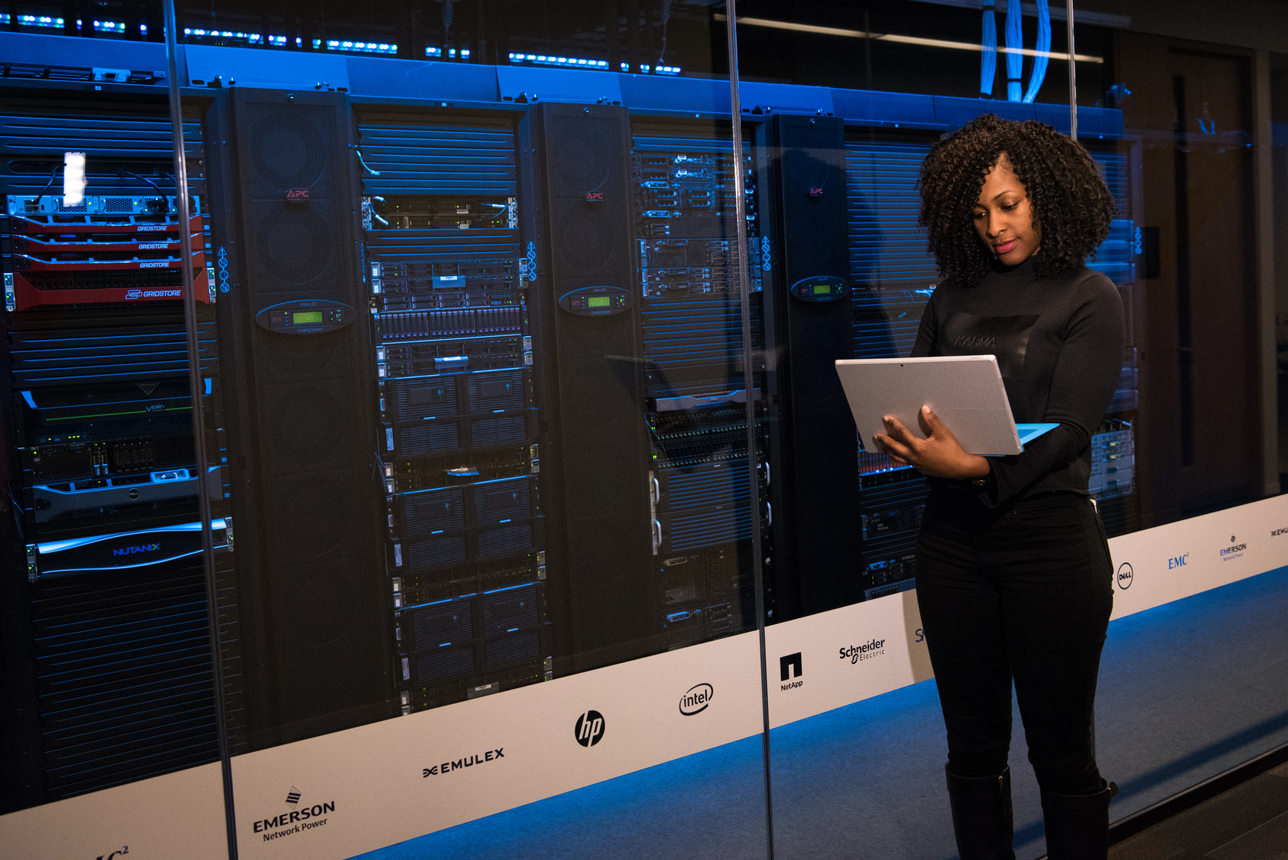


Future Enhancements
Adding more advanced features
Improving user experience
Scaling the project for larger traffic
e.g., product recommendations, reviews
UI/UX improvements

Slide 12
Presentation by :
Mohamed Mattar
Supervisor
Eng. Mahmoud Khalid
BUG CRUSHERS
Final Project
TEAM 1
Team Leader: Ziad Ghoraba

